Slide 1
TOPICS TO BE COVERED IN THIS LECTURE
Elementary Matrices and examples
Properties of elementary matrices and their proofs
Invertible Matrices
Laws of Exponent and their proofs

Slide 2
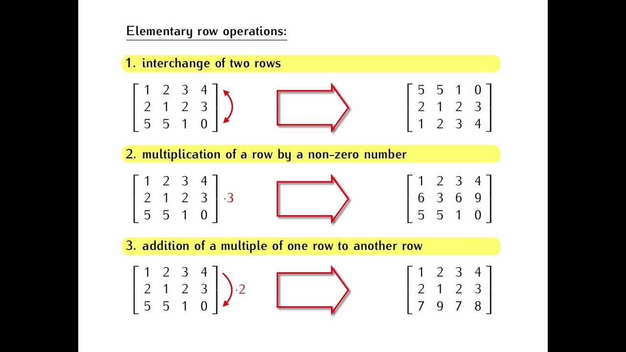
ELEMENTARY MATRICES
The matrices obtained by applying elementary
operations to identity matrices I_{n} are called
elementary matrices E.
Elementary row operations are:
Interchange of any two rows
Multiplication of a row by a non
zero number. i.e. (1/C)R_{i} ,where C
is a constant
iii. Addition of a multiple of one row
to another i.e. R_{i} – DR_{j} , here D is a
constant

Slide 3

EXAMPLE OF ELEMENTARY ROW OPERATIONS
For e.g.
I₂ = $\left[ \begin{aligned}1 0 \\ 0 1\end{aligned} \right]$
If we interchange row1 by row2
E₁ = $\left[ \begin{aligned}0 1 \\ 1 0\end{aligned} \right]$ it is a elementary matrix
Dividing row2 of identity matrix by 5
E₂ = $\left[ \begin{aligned}1 0 \\ 0 1/5\end{aligned} \right]$ it is another elementary matrix

Slide 4
PROPERTIES OF ELEMENTARY MATRICES
If the elementary matrix E results from performing a certain row operation on I_{n} and if A is an m×n matrix, then the product EA is the matrix that results when this same row operation is performed on A.
Every elementary matrix is invertible, and the inverse is also an elementary matrix.

Slide 5


1ST PROPERTY: If the elementary matrix E results from performing a certain row operation on I_{n} and if A is an m×n matrix, then the product EA is the matrix that results when this same row operation is performed on A.
A = $\left[ \begin{aligned}1 2 \\ 3 4\end{aligned} \right]$
and I₂ = $\left[ \begin{aligned}1 0 \\ 0 1\end{aligned} \right]$
Now I am applying a row operation i.e. R₂ – 3R₁ on I₂ to get an elementary matrix. So,
E = $\left[ \begin{aligned}1 0 \\ −3 1\end{aligned} \right]$
EA = $\left[ \begin{aligned}1 0 \\ −3 1\end{aligned} \right]× \left[ \begin{aligned}1 2 \\ 3 4\end{aligned} \right]$
R₂ – 3R₁
$$\left[0 1\right] −3\left[1 0\right]$$
$$\left[0 1\right] −\left[3 0\right]$$
New R₂ = $\left[−3 1\right]$

Slide 6

Cont.
EA = $\left[ \begin{aligned}1 0 \\ −3 1\end{aligned} \right]× \left[ \begin{aligned}1 2 \\ 3 4\end{aligned} \right]$
EA = $\left[ \begin{aligned}(1∗1)+(0∗3) (1∗2)+(0∗4) \\ (−3∗1)+(1∗3) (−3∗2)+(1∗4)\end{aligned} \right]$
EA = $\left[ \begin{aligned}1+0 2+0 \\ −3+3 −6+4\end{aligned} \right]$
EA = $\left[ \begin{aligned}1 2 \\ 0 −2\end{aligned} \right]$
1ST PROPERTY: If the elementary matrix E results from performing a certain row operation on I_{n} and if A is an m×n matrix, then the product EA is the matrix that results when this same row operation is performed on A.

Slide 7


Cont.
We get,
E = $\left[ \begin{aligned}1 0 \\ −3 1\end{aligned} \right]$
EA = $\left[ \begin{aligned}1 2 \\ 0 −2\end{aligned} \right]$
As we have applied this row operation i.e. R₂ – 3R₁
on I_{2,} we will apply same row operation on Matrix A
to check 1st property.
A = $\left[ \begin{aligned}1 2 \\ 3 4\end{aligned} \right]$
R₂ – 3R₁
A’ = $\left[ \begin{aligned}1 2 \\ 0 −2\end{aligned} \right]$
1ST PROPERTY: If the elementary matrix E results from performing a certain row operation on I_{n} and if A is an m×n matrix, then the product EA is the matrix that results when this same row operation is performed on A.
So, We can say that EA = A’
Where A’ is the matrix, obtained after applying the row operation to matrix A
R₂ – 3R₁
$$\left[3 4\right] −3\left[1 2\right]$$
$$\left[3 4\right] −\left[3 6\right]$$
New R₂ = $\left[0 −2\right]$

Slide 8

2nd Property: Every elementary matrix is invertible, and the inverse is also an elementary matrix.
From the previous slides we have seen that E
E = $\left[ \begin{aligned}1 0 \\ −3 1\end{aligned} \right]$
elementary matrix, obtained by applying this row operation i.e. R₂ – 3R₁ on I_{2.} where
I₂ = $\left[ \begin{aligned}1 0 \\ 0 1\end{aligned} \right]$
According to the property, every elementary matrix is invertible. So,
$\left|E\right|$ = $\left|\begin{aligned}1 0 \\ −3 1\end{aligned}\right|$ = (1*1)-(0*-3)
$\left|E\right|$ = 1 non singular so it is invertible. Second property is verified

Slide 9

INVERTIBLE MATRIX
Matrix A is invertible (non singular i.e. det(A) ≠ 0) if Matrix A is an n$×$n matrix such that
AB = BA = I_{n}
I_{n} is the identity matrix and B is the inverse of A, i.e. B = A⁻¹.

Slide 10

INVERTIBILITY OF MATRIX
A= $\left[\begin{aligned} 1 −2 3 \\ 3 5 2 \\ −1 3 −4\end{aligned}\right]$
Find that the given matrix is invertible or not ?
$\left|A\right|$ = $\left|\begin{aligned}1 −2 3 \\ 3 5 2 \\ −1 3 −4\end{aligned}\right|$
$\left|A\right|$ = 1(-20 -6) –(-2)*(-12 +2) + 3(9+5)
$\left|A\right|$ = -4 $≠$ 0
So, matrix A is invertible and A$×$B or A$×$A⁻¹ = I_{n}

Slide 11

Question 2
A= $\left[\begin{aligned}1 2 −1 \\ 3 7 −10 \\ 7 16 −21\end{aligned}\right]$
Find that the given matrix is invertible or not ?
$\left|A\right|$ = $\left|\begin{aligned}1 2 −1 \\ 3 7 −10 \\ 7 16 −21\end{aligned}\right|$
$\left|A\right|$ = 0
this is a singular matrix so is not invertible

Slide 12

INVERSE OF A MATRIX: LAWS OF EXPONENT
If A is an invertible matrix
A⁻¹ is invertible (A⁻¹)⁻¹ = A
A^{n} is invertible and (A^{n})⁻¹ = (A⁻¹)^{n}
For any non zero scalar K, the matrix KA is invertible &
(kA)⁻¹ = $\frac{1}{K}$A⁻¹

Slide 13


Proof Of 1st Law
Question: Prove the three laws of exponent For given matrix
A = $\left[ \begin{aligned}1 2 \\ 1 3\end{aligned} \right]$
To show (A⁻¹)⁻¹ = A
A⁻¹ = $\frac{1}{\left|A\right|}$ (adj of A)
$\left|A\right|$ = (1*3)-(2*1)
$\left|A\right|$ = 1
Adj(A) = $\left[ \begin{aligned} 3 −2 \\ −1 1\end{aligned} \right]$

Slide 14


Cont.
As we know that
A⁻¹ = $\frac{1}{\left|A\right|}$ (adj of A)
A⁻¹ = $\left[ \begin{aligned} 3 −2 \\ −1 1\end{aligned} \right]$
Now, we have to find (A⁻¹)⁻¹
Adj(A⁻¹) = $\left[ \begin{aligned}1 2 \\ 1 3\end{aligned} \right]$
$\left|\text{A}\text{−1}\right|$ = (1*3)-(-2*1)
$\left|\text{A}\text{−1}\right|$ = 1
Adj(A) = $\left[ \begin{aligned} 3 −2 \\ −1 1\end{aligned} \right]$
$\left|A\right|$ = 1

Slide 15


Cont.
(A⁻¹)⁻¹ = $\frac{1}{\left|\text{A}\text{−1}\right|}$ (adj of A⁻¹)
(A⁻¹)⁻¹ = $\left[ \begin{aligned}1 2 \\ 1 3\end{aligned} \right]$
We are given matrix A
A = $\left[ \begin{aligned}1 2 \\ 1 3\end{aligned} \right]$
Adj (A⁻¹) = $\left[ \begin{aligned}1 2 \\ 1 3\end{aligned} \right]$
$\left|\text{A}\text{−1}\right|$ = 1
L.H.S = R.H.S
(A⁻¹)⁻¹ = A
Hence proved

Slide 16

Proof Of 2nd Law
A = $\left[ \begin{aligned}1 2 \\ 1 3\end{aligned} \right]$
To show that (A^{n})⁻¹ = (A⁻¹)^{n}
Let n = 3
So, to show that
(A³)⁻¹ = (A⁻¹)³
Consider L.H.S
A³ = $\left[ \begin{aligned}1 2 \\ 1 3\end{aligned} \right]×\left[ \begin{aligned}1 2 \\ 1 3\end{aligned}\right]×\left[ \begin{aligned}1 2 \\ 1 3\end{aligned} \right]$
A³ = $\left[ \begin{aligned}1+2 2+6 \\ 1+3 2+9\end{aligned} \right]×\left[ \begin{aligned}1 2 \\ 1 3\end{aligned} \right]$

Slide 17

Cont.
A³ = $\left[ \begin{aligned}1+2 2+6 \\ 1+3 2+9\end{aligned} \right]×\left[ \begin{aligned}1 2 \\ 1 3\end{aligned} \right]$
A³ = $\left[ \begin{aligned}3 8 \\ 4 11\end{aligned} \right]×\left[ \begin{aligned}1 2 \\ 1 3\end{aligned} \right]$
A³ = $\left[ \begin{aligned}11 30 \\ 15 41\end{aligned} \right]$
(A³)⁻¹ = $\frac{1}{\left|\text{A}\text{3}\right|}$ (adj of A³)
Remember
We have to find (A³)⁻¹

Slide 18


Cont.
A³ = $\left[ \begin{aligned}11 30 \\ 15 41\end{aligned} \right]$
(A³)⁻¹ = $\frac{1}{\left|\text{A}\text{3}\right|}$ (adj of A³)
(A³)⁻¹ = $\left[ \begin{aligned}41 −30 \\ −15 11\end{aligned} \right]$
Adj (A³) =$\left[ \begin{aligned}41 −30 \\ −15 11\end{aligned} \right]$
$\left|\text{A}\text{3}\right|$ = 1

Slide 19

Cont.
(A³)⁻¹ = (A⁻¹)³
Now, Consider R.H.S i.e. (A⁻¹)³
A⁻¹ = $\left[ \begin{aligned} 3 −2 \\ −1 1\end{aligned} \right]$
(A⁻¹)³ = $\left[ \begin{aligned} 3 −2 \\ −1 1\end{aligned} \right]×\left[ \begin{aligned} 3 −2 \\ −1 1\end{aligned} \right]×\left[ \begin{aligned} 3 −2 \\ −1 1\end{aligned} \right]$
(A⁻¹)³ = $\left[ \begin{aligned} 11 −8 \\ −4 3\end{aligned} \right]$ $×$ $\left[ \begin{aligned} 3 −2 \\ −1 1\end{aligned} \right]$
(A⁻¹)³ = $\left[ \begin{aligned}41 −30 \\ −15 11\end{aligned} \right]$
L.H.S = R.H.S
(A³)⁻¹ = (A⁻¹)³
Hence proved

Slide 20

Proof Of 3rd Law
For any non zero scalar K, the matrix KA is invertible &
(kA)⁻¹ = $\frac{1}{K}$A⁻¹
Consider L.H.S
Let K = 2
KA = 2$×\left[ \begin{aligned}1 2 \\ 1 3\end{aligned}\right]$
KA = $\left[ \begin{aligned}2 4 \\ 2 6\end{aligned}\right]$
Remember
We have to find (kA)⁻¹

Slide 21


Cont.
KA = $\left[ \begin{aligned}2 4 \\ 2 6\end{aligned}\right]$
Since (AB)⁻¹ = B⁻¹A⁻¹
Therefore (KA)⁻¹ = A⁻¹ K⁻¹
(KA)⁻¹ = A⁻¹ K⁻¹
(KA)⁻¹ = $\left[ \begin{aligned} 3 −2 \\ −1 1\end{aligned} \right]$ $×$ 2⁻¹
(KA)⁻¹ = $\left[ \begin{aligned} 3 −2 \\ −1 1\end{aligned} \right]$ $×$ (1/2)
(KA)⁻¹ = $\left[ \begin{aligned} 3/2 −1 \\ −1/2 1/2\end{aligned} \right]$
Remember
We have to find (kA)⁻¹
A⁻¹ = $\left[ \begin{aligned} 3 −2 \\ −1 1\end{aligned} \right]$ & K = 2

Slide 22



Cont.
A⁻¹ = $\left[ \begin{aligned} 3 −2 \\ −1 1\end{aligned} \right]$ & K = 2
(kA)⁻¹ = $\frac{1}{K}$A⁻¹
Consider R.H.S
$\frac{1}{K}$A⁻¹ = (1/2) $×$ $\left[ \begin{aligned} 3 −2 \\ −1 1\end{aligned} \right]$
$\frac{1}{K}$A⁻¹ = $\left[ \begin{aligned} 3/2 −1 \\ −1/2 1/2\end{aligned} \right]$
L.H.S = R.H.S
(kA)⁻¹ = $\frac{1}{K}$A⁻¹
Hence proved

Slide 23
QUESTION
If $\text{A}$ = $\left[ \begin{aligned}\text{3} \text{−2} \text{4} \\ \text{1} \text{0} \text{2} \\ \text{0} \text{1} \text{0}\end{aligned} \right]$
Proof the following
If A is an invertible matrix
A⁻¹ is invertible (A⁻¹)⁻¹ = A
A^{n} is invertible and (A^{n})⁻¹ = (A⁻¹)^{n}
For any non zero scalar K, the matrix KA is invertible &
(kA)⁻¹ = $\frac{1}{K}$A⁻¹

Slide 24
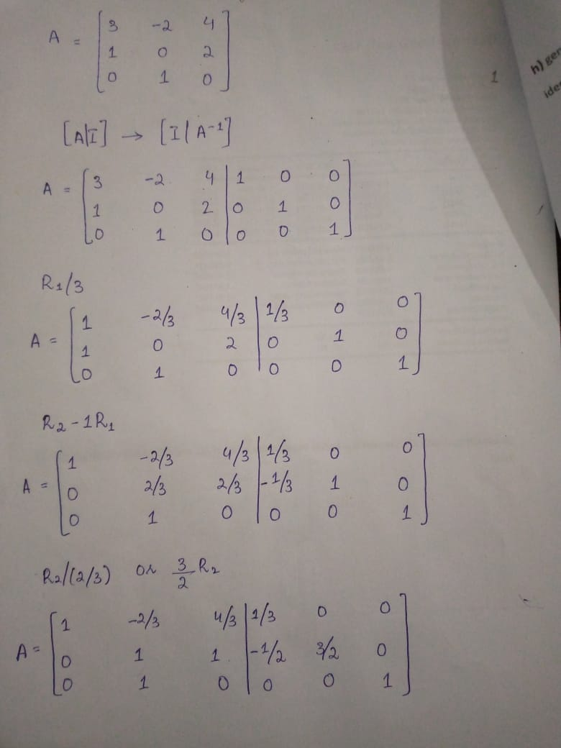
1st PROPERTY:
$\text{A}$ = $\left[ \begin{aligned}\text{3 } \text{−2} \text{4} \\ \text{1} \text{0} \text{2} \\ \text{0} \text{1} \text{0}\end{aligned} \right]$
To prove
A⁻¹ is invertible (A⁻¹)⁻¹ = A
Consider L.H.s

Slide 25
Cont.

Slide 26
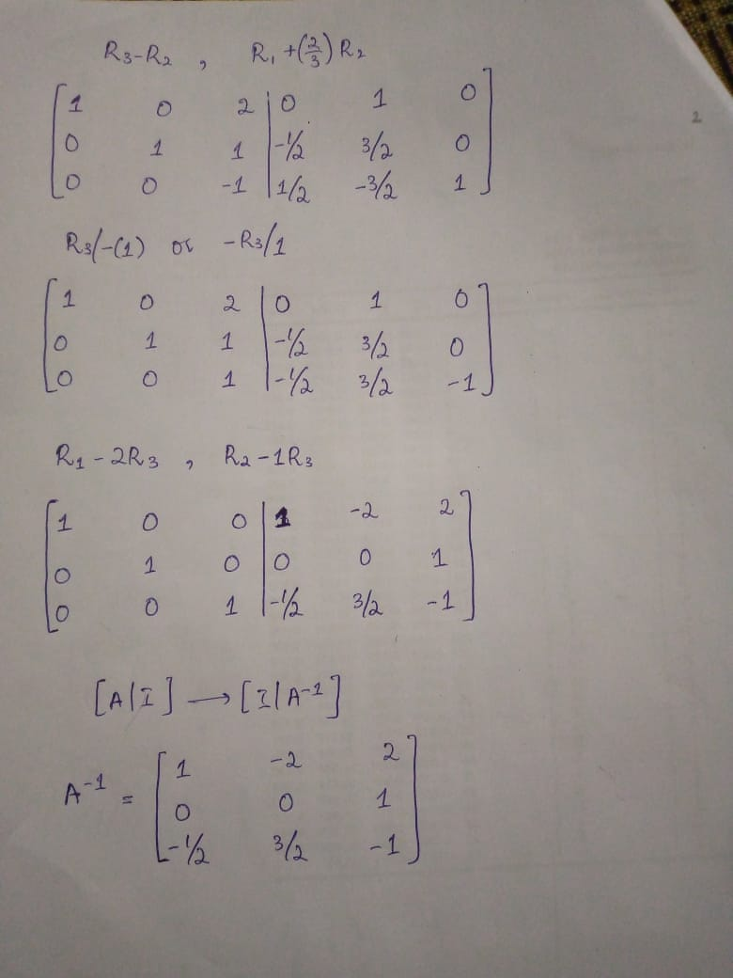
Cont.

Slide 27
Cont.
A⁻¹ = $\left[ \begin{aligned}\text{1 } \text{−2} \text{2} \\ \text{0} \text{0} \text{1} \\ \text{−1/2} \text{3/2} \text{−1}\end{aligned} \right]$
Remember that
We have to prove that
(A⁻¹)⁻¹ = A
& L.H.S is (A⁻¹)⁻¹

Slide 28
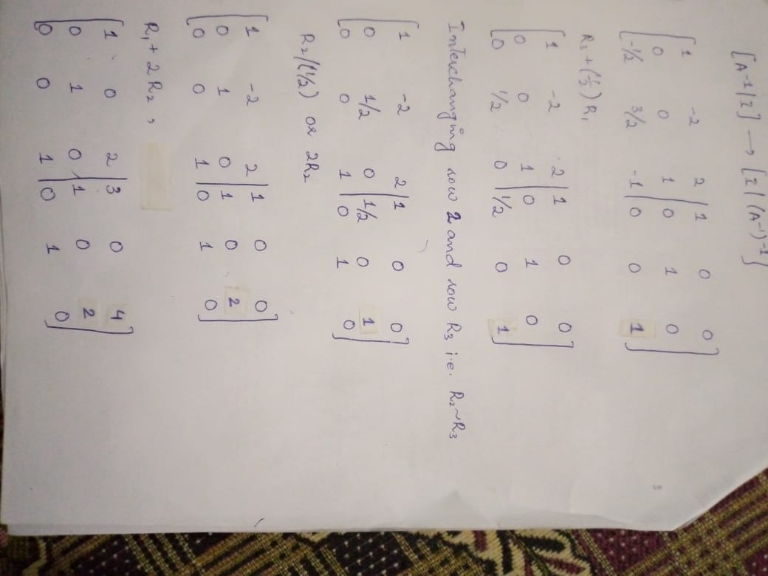
Cont.
We have calculated A⁻¹
Which is
A⁻¹ = $\left[ \begin{aligned}\text{1} \text{−2} \text{2} \\ \text{0} \text{0} \text{1} \\ \text{−1/2} \text{3/2} \text{−1}\end{aligned} \right]$
Now We have to calculate (A⁻¹)⁻¹
As we know that $\left( A | I \right)$ → $\left( I | \text{A}\text{−1}\right)$
So,
$\left(\text{A}\text{−1 } | I \right)$ → $\left(\text{I} | \text{(}\text{A}\text{−1}\text{)}\text{−1}\right)$

Slide 29
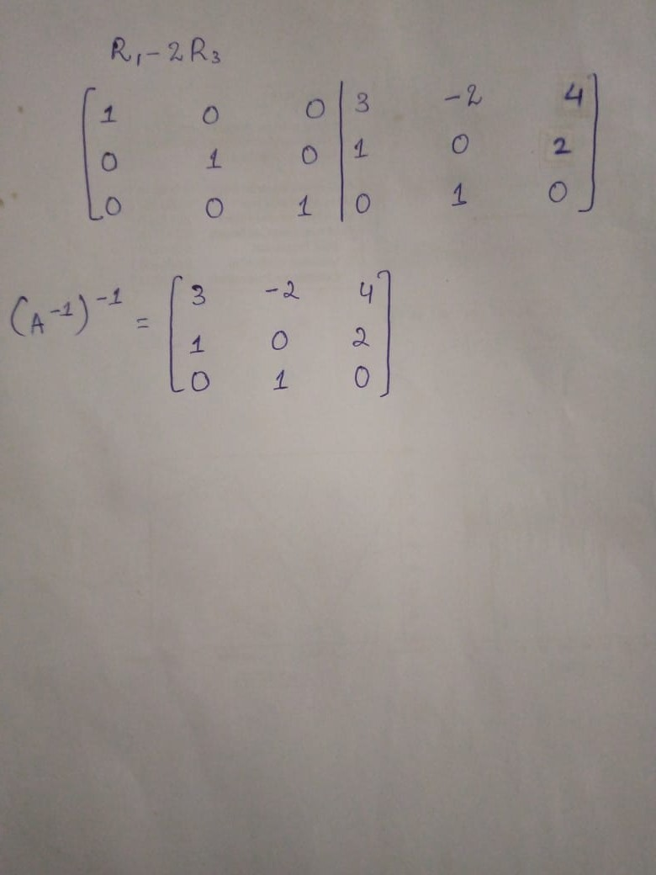
Cont.

Slide 30
Cont.
(A⁻¹)⁻¹ = $\left[ \begin{aligned}\text{3} \text{−2} \text{4} \\ \text{1} \text{0} \text{2} \\ \text{0} \text{1} \text{0}\end{aligned} \right]$
$\text{A}$ = $\left[ \begin{aligned}\text{3 } \text{−2} \text{4} \\ \text{1} \text{0} \text{2} \\ \text{0} \text{1} \text{0}\end{aligned} \right]$
L.H.S = R.H.S
First property is,
(A⁻¹)⁻¹ = A

Slide 31
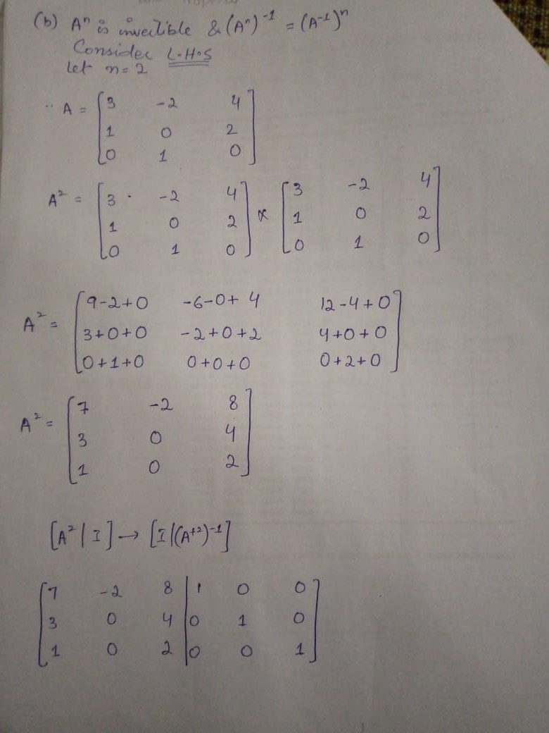
2nd PROPERTY:
$\text{A}$ = $\left[ \begin{aligned}\text{3 } \text{−2} \text{4} \\ \text{1} \text{0} \text{2} \\ \text{0} \text{1} \text{0}\end{aligned} \right]$
To prove
A^{n} is invertible
& (A^{n})⁻¹ = (A⁻¹)^{n}
Let n= 2
Consider L.H.S

Slide 32
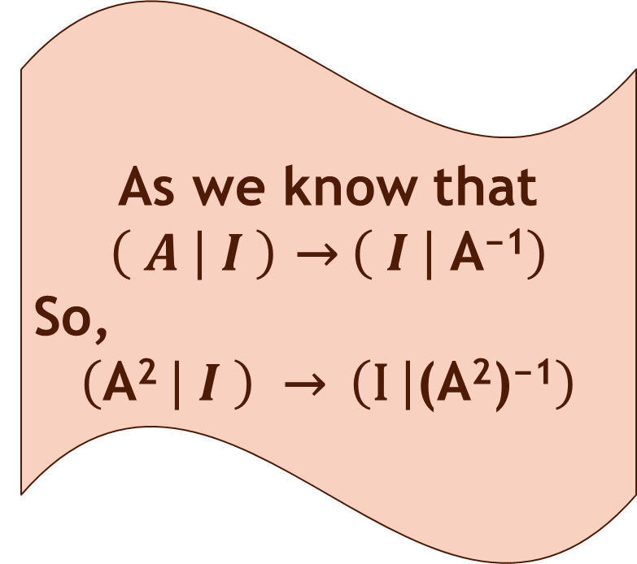
Cont.
Remember that
L.H.S
(A^{n})⁻¹ = (A²)⁻¹
As we know that
$\left( A | I \right)$ → $\left( I | \text{A}\text{−1}\right)$
So,
$\left(\text{A}\text{2} | I \right)$ → $\left(\text{I} | \text{(}\text{A}\text{2}\text{)}\text{−1}\right)$

Slide 33
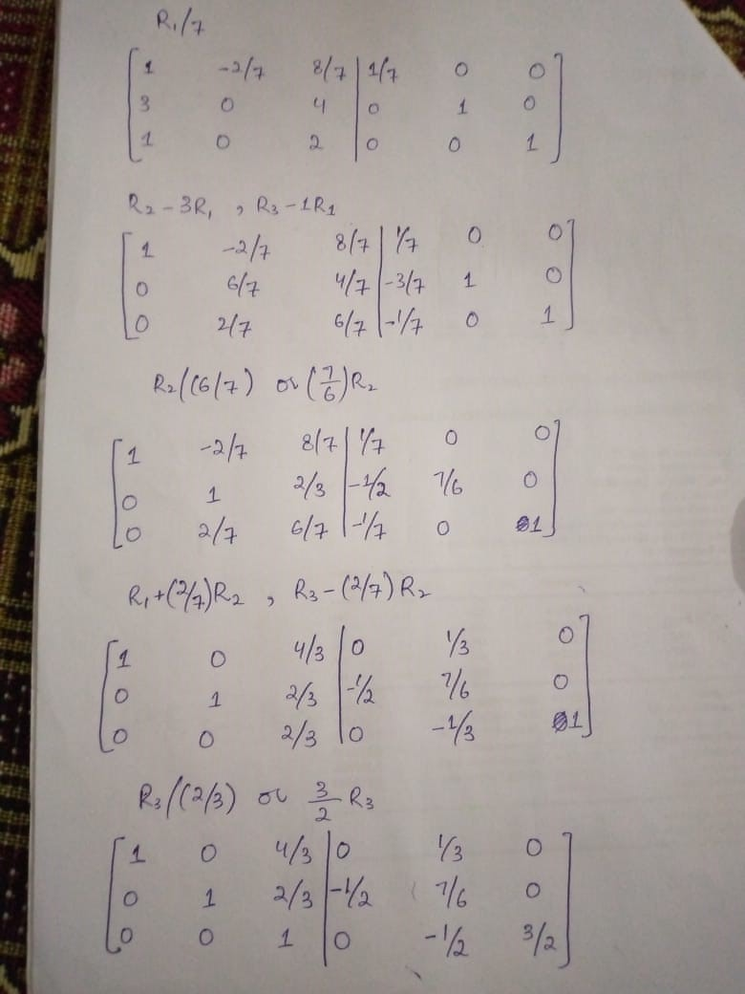
Cont.

Slide 34
Cont.

Slide 35
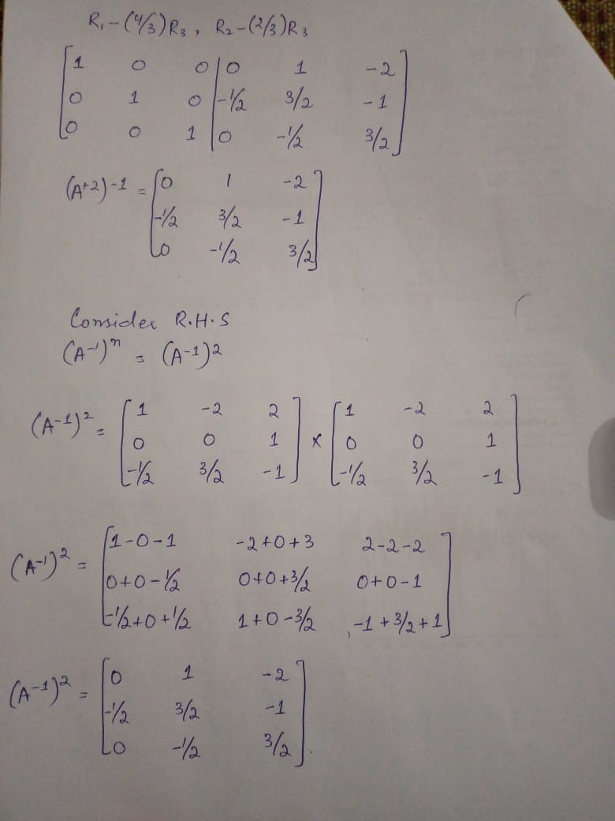
Cont.

Slide 36
Cont.
(A²)⁻¹ = $\left[ \begin{aligned}\text{0} \text{1} \text{−2} \\ \text{−1/2} \text{3/2} \text{−1} \\ \text{0} \text{−1/2} \text{3/2}\end{aligned} \right]$
REMEMBER
TO PROVE
(A²)⁻¹ = (A⁻¹)²

Slide 37
Cont.
A⁻¹ = $\left[ \begin{aligned}\text{1 } \text{−2} \text{2} \\ \text{0} \text{0} \text{1} \\ \text{−1/2} \text{3/2} \text{−1}\end{aligned} \right]$
REMEMBER
R.H.S is
(A⁻¹)^{n} =(A⁻¹)²

Slide 38
Cont.
L.H.S
(A²)⁻¹ = $\left[ \begin{aligned}\text{0 } \text{1} \text{−2} \\ \text{−1/2} \text{3/2} \text{−1} \\ \text{0} \text{−1/2} \text{3/2}\end{aligned} \right]$
To Show
(A^{n})⁻¹ = (A⁻¹)^{n}
Since n = 2
(A²)⁻¹ = (A⁻¹)²
L.H.S = R.H.S
Hence proved
R.H.S
(A⁻¹)² $= \left[ \begin{aligned}\text{0 } \text{1} \text{−2} \\ \text{−1/2} \text{3/2} \text{−1} \\ \text{0} \text{−1/2} \text{3/2}\end{aligned} \right]$

Slide 39
3rd PROPERTY:
$\text{A}$ = $\left[ \begin{aligned}\text{3 } \text{−2} \text{4} \\ \text{1} \text{0} \text{2} \\ \text{0} \text{1} \text{0}\end{aligned} \right]$
To Show
For any non zero scalar K, the matrix KA is invertible &
(kA)⁻¹ = $\frac{1}{K}$A⁻¹
Let k = 2

Slide 40
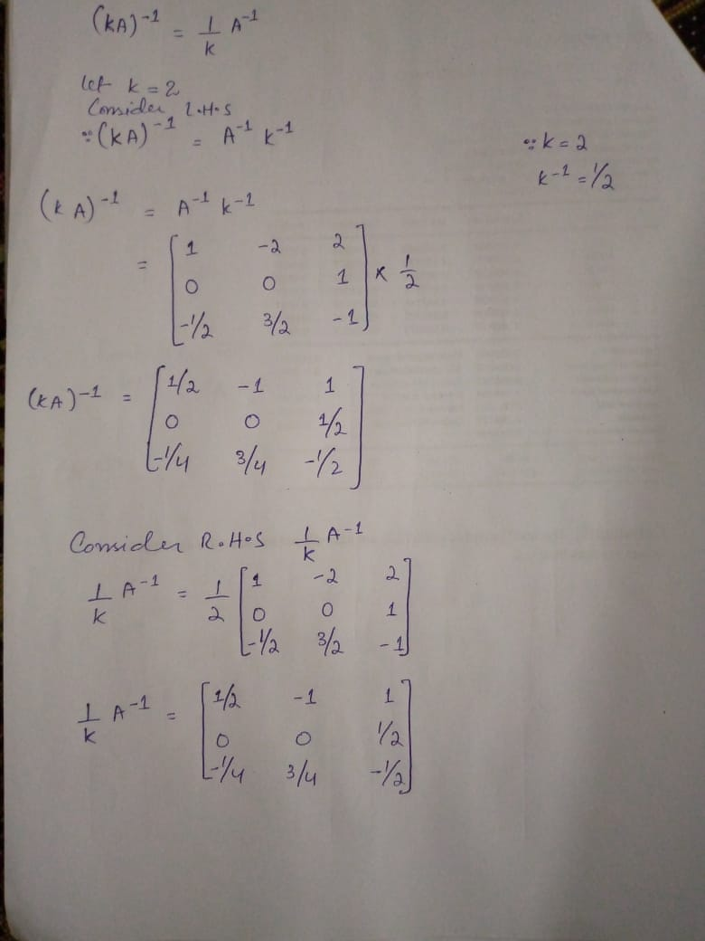
Cont.
(kA)⁻¹ = $\frac{1}{K}$A⁻¹
Consider L.H.S
As we know that
(kA)⁻¹ = A⁻¹ k⁻¹
We have calculated A⁻¹ for 1st
property
A⁻¹ = $\left[ \begin{aligned}\text{1 } \text{−2} \text{2} \\ \text{0} \text{0} \text{1} \\ \text{−1/2} \text{3/2} \text{−1}\end{aligned} \right]$

Slide 41
Cont.
Property:
(kA)⁻¹ = $\frac{1}{K}$A⁻¹
Consider R.H.S
$\frac{1}{K}$A⁻¹ = $\frac{1}{2}$A⁻¹

Slide 42
Cont.
L.H.S
(KA)⁻¹ = (2A)⁻¹ = $\left[ \begin{aligned}\text{1/2 } \text{−1} \text{1} \\ \text{0} \text{0} \text{1/2} \\ \text{−1/4} \text{3/4} \text{−1}\text{/2}\end{aligned} \right]$
To Show
(kA)⁻¹ = $\frac{1}{K}$A⁻¹
Since k = 2
(2A)⁻¹ = $\frac{1}{2}$A⁻¹
L.H.S = R.H.S
Hence proved
R.H.S
$\frac{1}{K}$A⁻¹ = $\frac{1}{2}$A⁻¹ = $\left[ \begin{aligned}\text{1/2 } \text{−1} \text{1} \\ \text{0} \text{0} \text{1/2} \\ \text{−1/4} \text{3/4} \text{−1}\text{/2}\end{aligned} \right]$

